Slide 1
Motional Narrowing
Wenxiang Ying

Slide 3
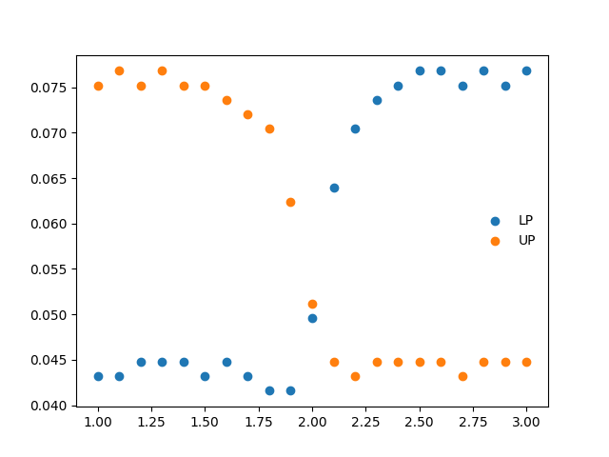
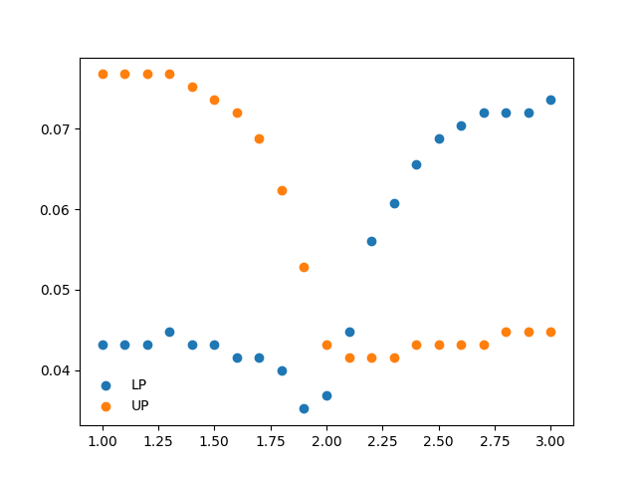
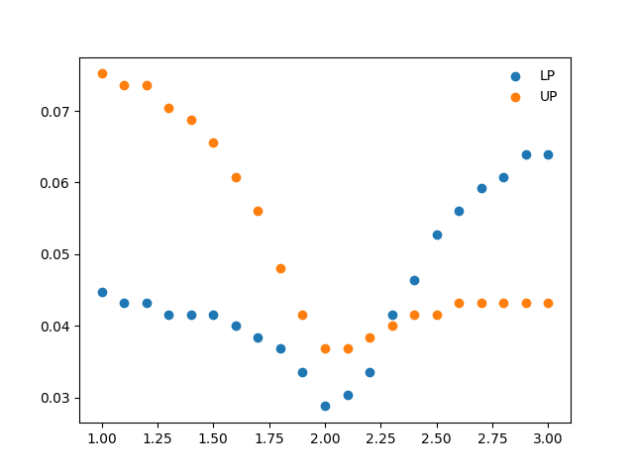
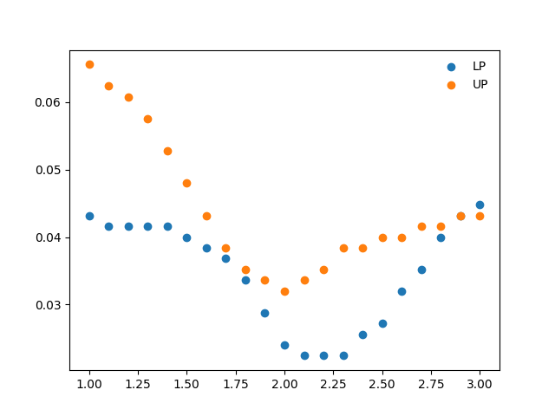
N = 1
N = 2
Width (eV)
Width (eV)
N = 4
N = 8
Width (eV)
Width (eV)
Cavity frequency (eV)
Cavity frequency (eV)

Slide 5
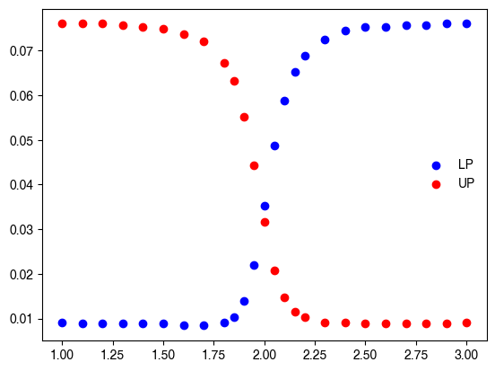
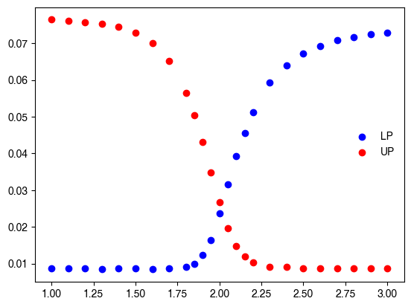
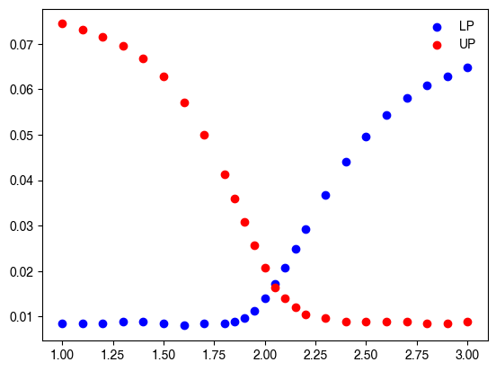
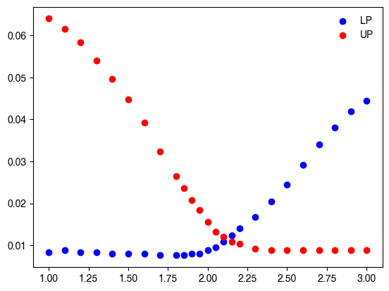

Slide 6
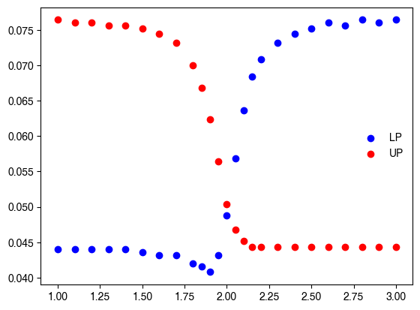
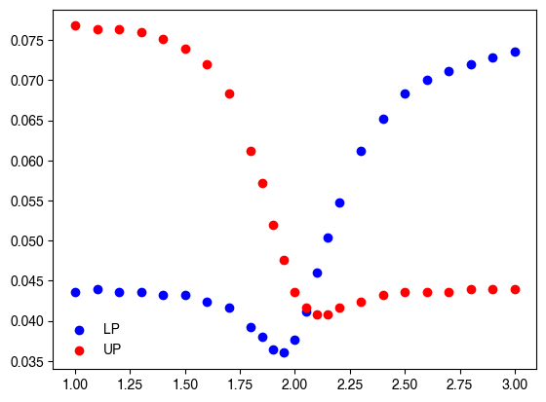
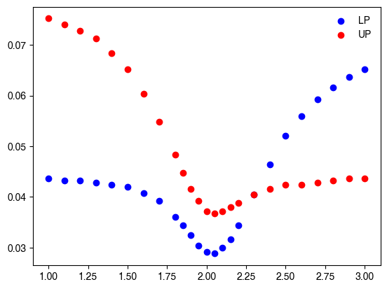
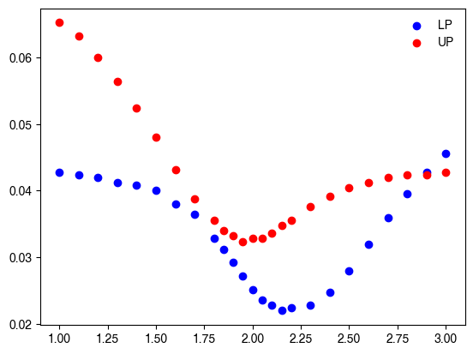

Slide 8
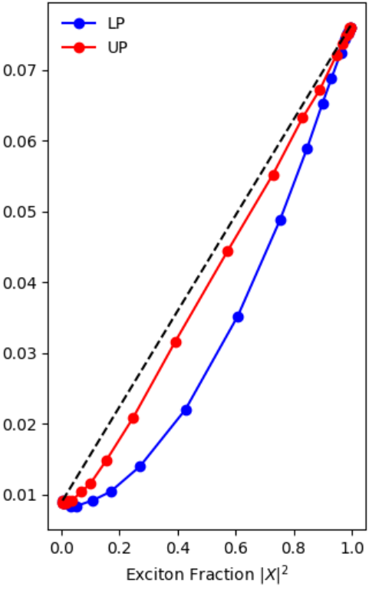
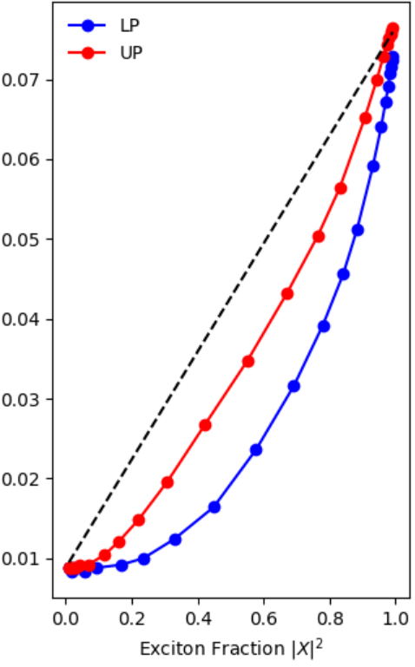
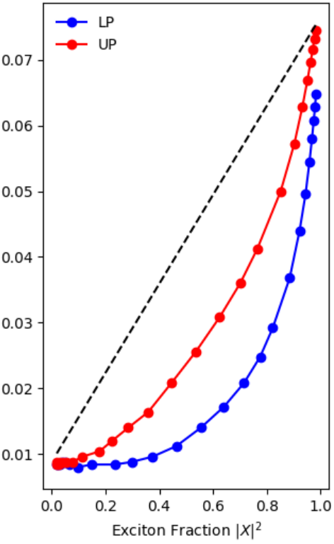
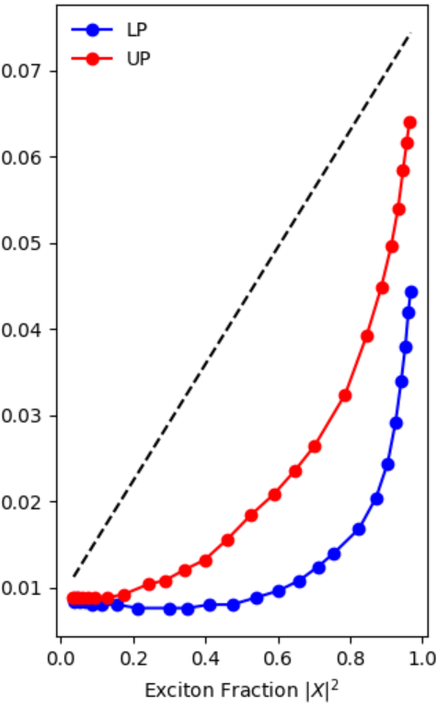

Slide 9
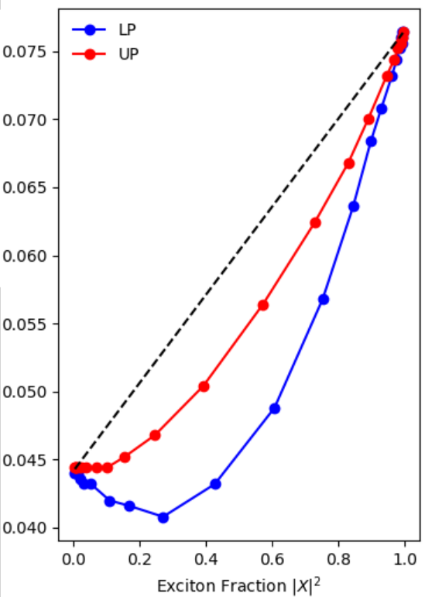
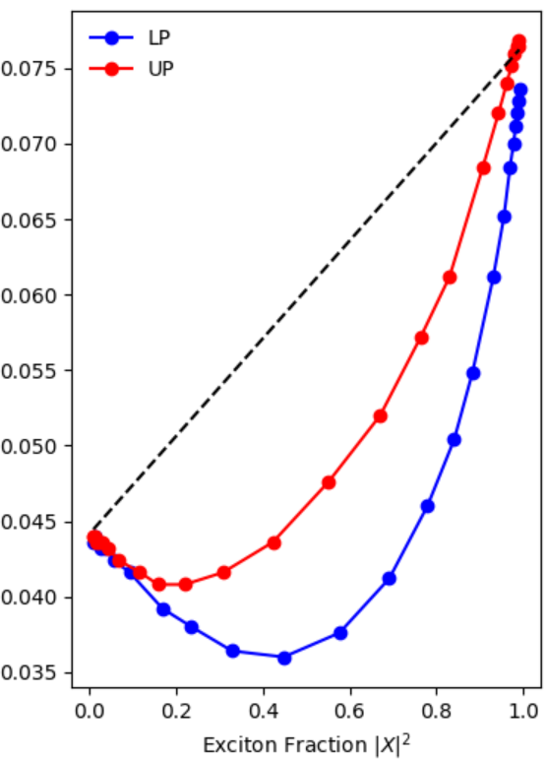
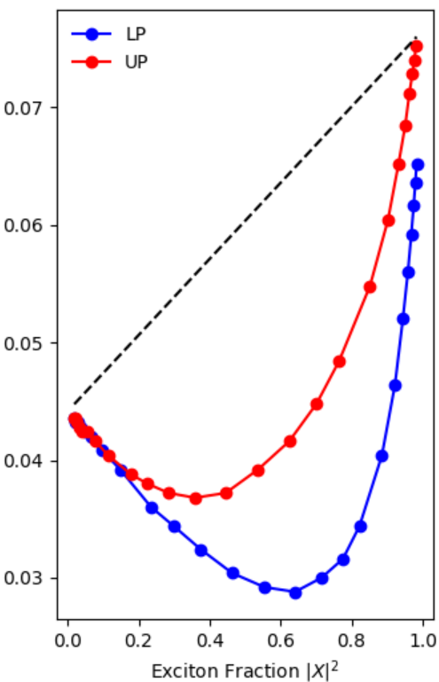
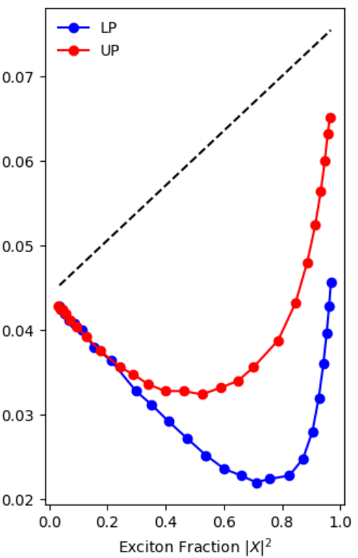

Slide 11

Enhancement of UP - LP Coherence
“Motional Narrowing”
Polariton Energy Gap Law
“Collectiveness” in PMET
Ballistic Transport
“It is said that wisdom lies not in seeing things, but seeing through things.”
Manly P. Hall
Polaron
Decoupling

Slide 12
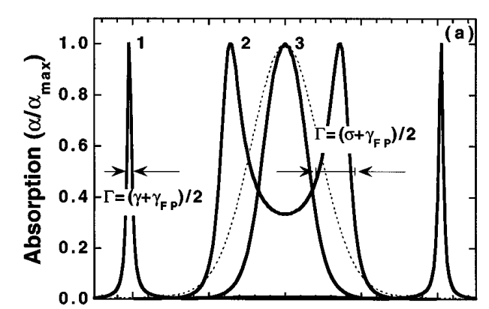
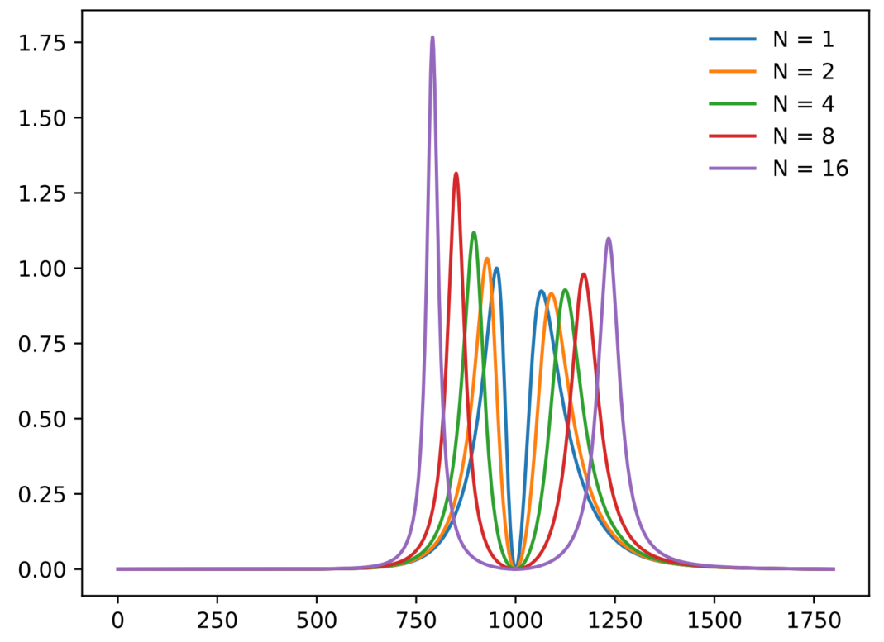
R. Houdre, et al., Phys. Rev. A. 53, 4 (1996)
Numerical simulation

Slide 13
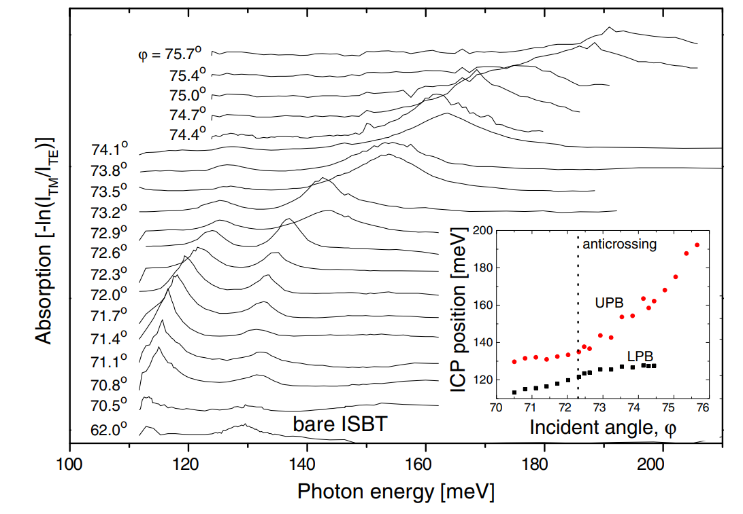
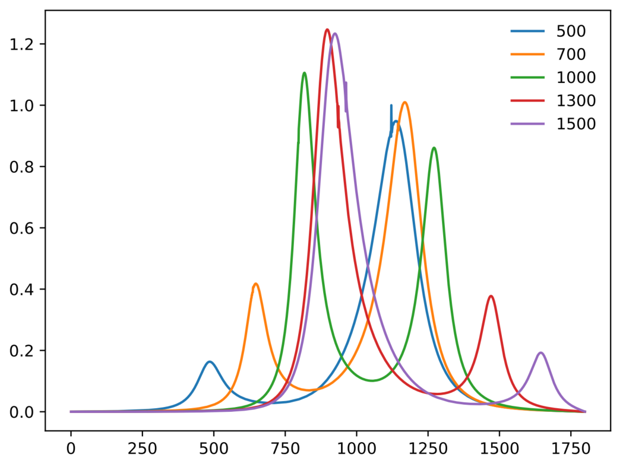
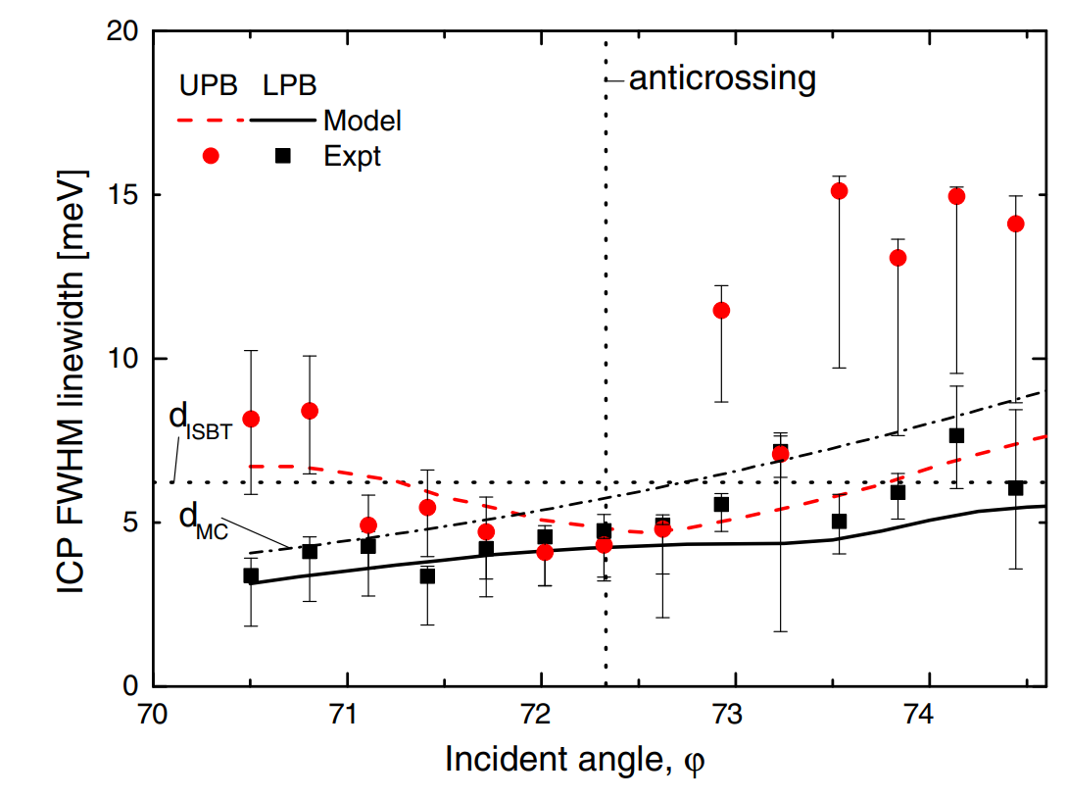
Cavity frequencies
F. J. Murphy, et al., Phys. Rev. B. 89, 205319 (2014)
Numerical simulation (with N=16, tauc = 50 fs)

Slide 14
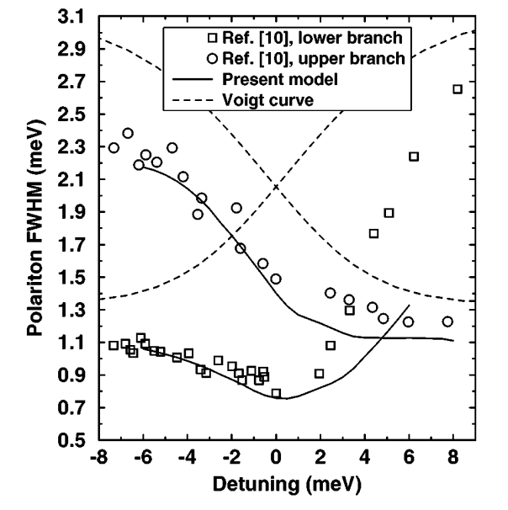
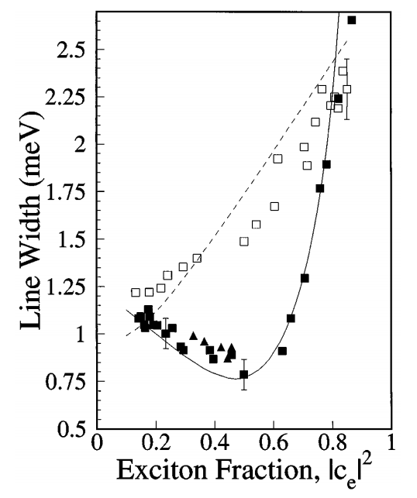
Upper branch
Lower branch
D. M. Whittaker, et al., Phys. Rev. Lett. 77, 23 (1996)
V. Savona, et al., Phys. Rev. Lett. 78, 23 (1997)

Slide 15
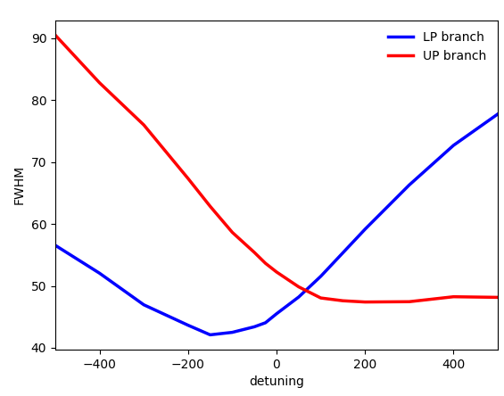
Pure photon
Pure exciton
Numerical simulation (N = 16, tauc = 50 fs)

